Slide 1
Feature Extraction and Selection
CIS662, Sep. 13, 2023

Slide 2
Class Exercise
Learning task: to predict someone’s final future GPA after 2 years
Inputs: all possible information from a graduate student’s application
Questions:
What attributes are useful for accurate prediction?
Which specific arithmetic combinations of attributes are more useful than the raw attributes themselves?
How would we discover these?

Slide 3
What are “Features” (in the ML context)
Attributes or their combinations that are most useful for the ML task, i.e., those which make it easier for learning to be accomplished.
Three kinds of features:
1. Attributes
2. Linear combinations of attributes
3. Nonlinear combinations of attributes

Slide 4
Example of a well-known feature
APGAR score: summarizing Appearance, Pulse, Grimace, Activity, Respiration for a newborn
 | Score of 0 | Score of 1 | Score of 2 | Component of backronym
Skin color | blue or pale all over | blue at extremities, body pink (acrocyanosis) | no cyanosis body and extremities pink | Appearance
Pulse rate | absent | < 100 beats per minute | ≥ 100 beats per minute | Pulse
Reflex irritability grimace | no response to stimulation | grimace on suction or aggressive stimulation | cry on stimulation | Grimace
Muscle Tone | none | some flexion | flexed arms and legs that resist extension | Activity
Respiratory effort | absent | weak, irregular, gasping | strong, robust cry | Respiration

Slide 5
Examples of domain-specific features
Natural language processing: bag of words, n-grams
Speech processing: phonemes, syllables
Image processing: straight line segments, curves, circle, other shape primitives
Medical diagnosis: clusters of related symptoms
Some ML models such as neural networks simultaneously perform feature extraction while solving a supervised learning problem.

Slide 6
Attributes may be strongly correlated!
Example: a student’s grades in Calculus 1 and Calculus 2 courses—usually (but not always) they are both low or both high.
So what?
A prediction may strongly depend on these attributes, but knowing either one is sufficient, the second one does not provide additional information for the prediction task.

Slide 7
Attribute Selection
Given: a labeled data set with many attributes, determine which attributes are (a) irrelevant; (b) useful; (c) most useful for the prediction task.
Best scenario: decide before applying an ML algorithm.
Usual scenario: learn model parameters first, and then perform post-hoc analysis.

Slide 8
“Early” decisions about attribute selection
Prior knowledge is helpful: delete attributes known to be merely identifiers of individual data (e.g., name, SUID, address, …)—doing this will prevent the possibility of spurious inferences.
Magnitude of correlation of attribute with the data label (or quantity to be predicted): if correlation is highly positive or negative, we know the attribute is more useful for prediction.
Correlation between attributes: if two attributes are strongly correlated (positively or negatively), one can be omitted.

Slide 9
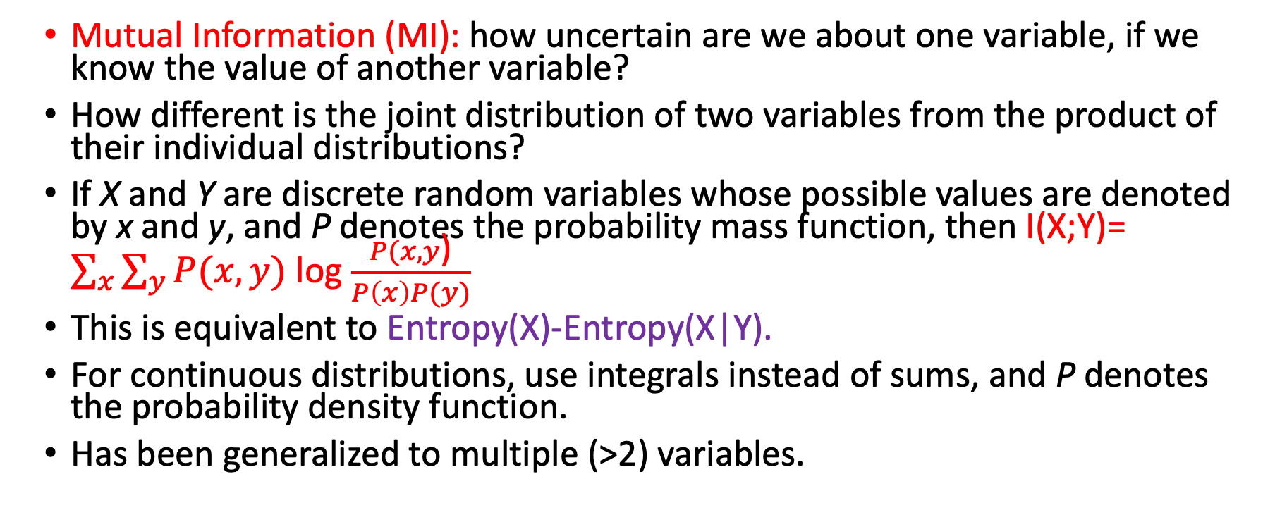
Can we do better than linear correlation?
Mutual Information (MI): how uncertain are we about one variable, if we know the value of another variable?
How different is the joint distribution of two variables from the product of their individual distributions?
If X and Y are discrete random variables whose possible values are denoted by x and y, and P denotes the probability mass function, then I(X;Y)= $\sum_{x}{\sum_{y}{P(x,y)}}$ log $\frac{P(x,y\text{)}}{P\left(x\right)P(y)}$
This is equivalent to Entropy(X)-Entropy(X|Y).
For continuous distributions, use integrals instead of sums, and P denotes the probability density function.
Has been generalized to multiple (>2) variables.

Slide 10
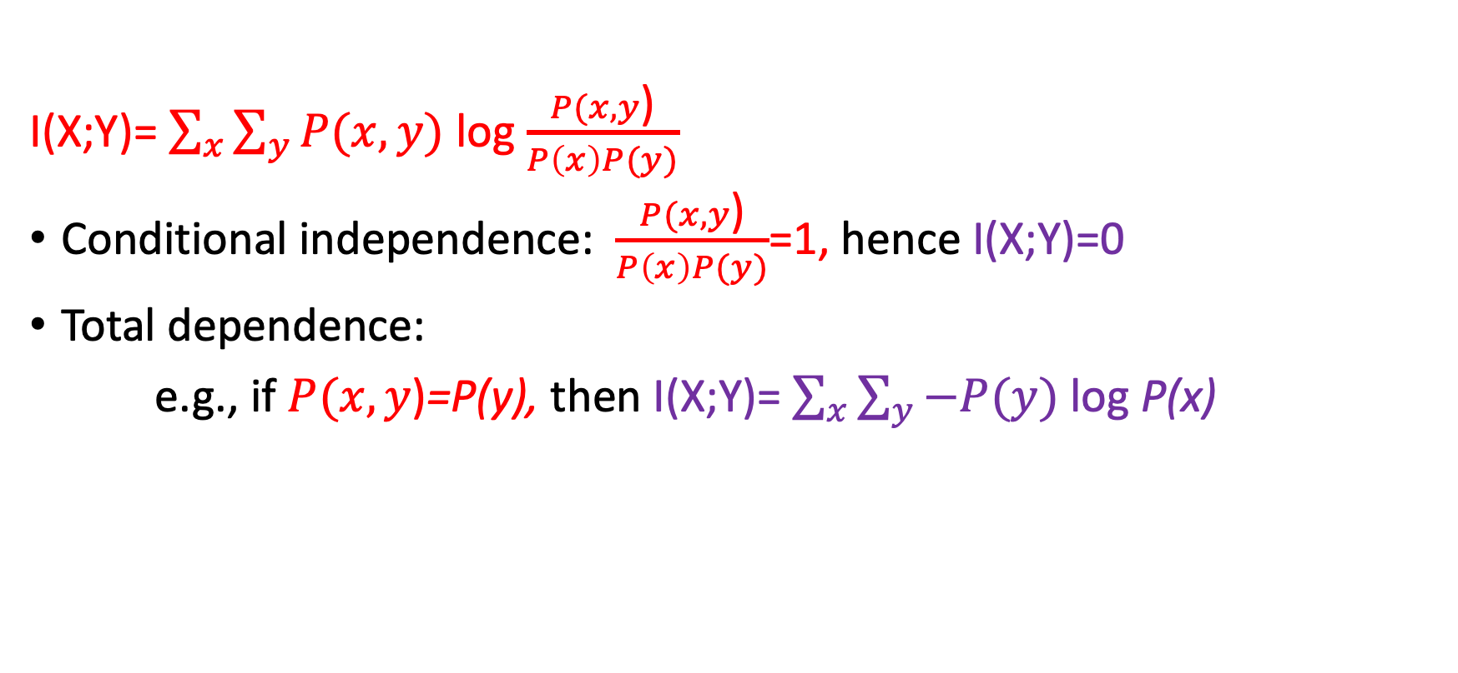
Extreme cases for Mutual Information
I(X;Y)= $\sum_{x}{\sum_{y}{P(x,y)}}$ log $\frac{P(x,y\text{)}}{P\left(x\right)P(y)}$
Conditional independence: $\frac{P(x,y\text{)}}{P\left(x\right)P(y)}$=1, hence I(X;Y)=0
Total dependence:
e.g., if $P(x,y\text{)}$=P(y), then I(X;Y)= $\sum_{x}{\sum_{y}{−P(y)}}$ log P(x)

Slide 11
Using Mutual Information for Feature Selection
How useful is an attribute X for predicting Y?
= How large is I(Y;X)?
Which subset of k attributes of input data are most useful for predicting Y?
= find the subset of attributes A with the highest I(Y; A).
How redundant is variable X, given variable Y?
= How large is I(X;Y)/(Entropy(X) + Entropy(Y)) ?

Slide 12
Linear Combinations of Attributes
Both correlation and mutual information focus on the given individual attributes by themselves.
What if we would like to find the most useful features that are linear combinations of attributes?
This is achieved by Principal Component Analysis.

Slide 13
Principal Component Analysis (PCA)
Given: data consisting of many attributes (columns in a table).
Find:
Among all possible (infinitely many) linear combinations of attributes, which one is the most useful?
Given k>0, mong all possible linear combinations of attributes which k linear combinations are (together) the most useful?
Alternate framing:
Which linear combinations capture the most information available in the given data?

Slide 14
Principal Component Analysis
Subtract the mean from every point.
Calculate the covariance matrix.
Compute its Eigenvectors and Eigenvalues.
Normalize the Eigenvectors to have unit length.[SVD]
Measure the relative importance of each Eigenvector as the ratio of its Eigenvalue to the sum of all Eigenvalues.
Select the k most important Eigenvectors.

Slide 15
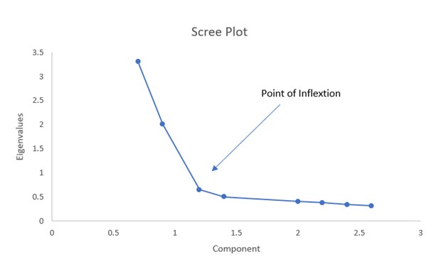
How many (k) Eigenvectors are enough?

Slide 16
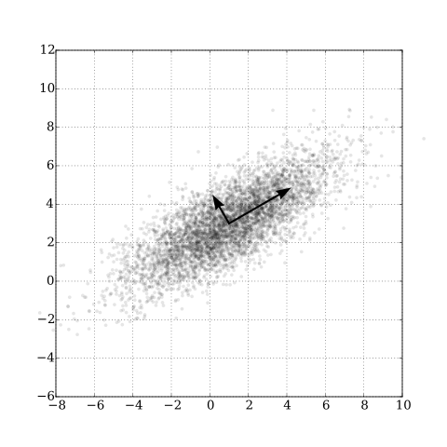
Finding Eigenvectors Iterative algorithms have been developed, but currently the most efficient approach is “Singular Value Decomposition”

Slide 17
Using Eigenvectors to identify Principal Components
Given: matrix A
1. Find vector X and value c such that AX=cX
--X is an Eigenvector and c is the corresponding Eigenvalue.
2. Find a set of mutually orthogonal Eigenvectors S (scaled to have unit length) and their corresponding Eigenvalues.
3. Find the set of unit length mutually orthogonal Eigenvectors sorted in the order of decreasing Eigenvalue magnitudes.
4. Select the first k among the set of unit length mutually orthogonal Eigenvectors sorted in the order of decreasing Eigenvalue magnitudes.
Notes:
EigenVectors are on the lines PC and for multiple they will be orthogonal to each other , the x and y are eigenvectors(direction) and the sum of squared distance of data points on the line / n – 1 is the eigenvalue

Slide 18
Geometric Perspective
Goal: to project d-dimensional data into k (<d) dimensions.
Information loss can occur when we project data into a low dimensional space; the best projections are those that minimize such information loss.
Merely ignoring d-k dimensions may result in too much information loss!
We can minimize information loss by projecting into a space whose basis vectors are the Eigenvectors corresponding to the largest Eigenvalues.
The amount of information loss can be assessed as proportional to the sum of the magnitudes of the remaining (unchosen) Eigenvalues.
PCA “rotates” the data space to align with the Eigenvectors that capture most of the variance in the given data.

Slide 19
Singular Value Decomposition (SVD)
Express a given matrix X (representing all available data) as the product of three other matrices, i.e., X=USW^{T}, where:
S is a rectangular diagonal matrix, [ Singular Value]
the columns of U are orthogonal unit vectors, and
W is a square matrix whose columns are orthogonal unit vectors.
Then the vectors of W are the Eigenvectors of X^{T}X, and the elements of S are the square roots of the Eigenvalues of X^{T}X.
Efficient algorithms exist for SVD computations, hence for PCA.

Slide 20
Nonlinear Attribute Combinations
What if we need to “discover” nonlinear attribute combinations that are most useful for a given problem?
Any not-too-lossy data compression technique can be thought of as accomplishing this goal.
Possible, but much more computation is needed.
Examples: (discrete) Fourier transform, Cosine transform, kernel PCA

Slide 21
Kernel PCA
Kernels: provide functions that map to higher-dimensional spaces within which data from different classes is linearly separable.
Clever tricks are used to facilitate fast computation, avoiding explicit representation, instead working with the dot products of transformed vectors.
Examples: Polynomial kernels, Gaussian kernels

Slide 22
Factor analysis
Methods describing observed data attributes as linear combinations of unobserved latent variables (plus some error).
Exploratory Factor Analysis: to identify relationships between observed attributes. If data is normally distributed, a Maximum Likelihood approach is used; else Principal Axis Factoring (similar to PCA).
Example: [Dabhade 2021] Problem dimensionality reduced from 92 to 2 using PCA, and ML algorithms were still able to perform well.
https://www.sciencedirect.com/science/article/pii/S2214785321042735

Slide 23
Other PCA variations
Independent Component Analysis (ICA): used to separate signals into independent non-Gaussian components, i.e., recovering pieces from a combination.
Canonical Correlation Analysis (CCA): transforms two sets of variables into projections in which their correlation is maximized.

Slide 24
PCA vs. Feature Selection from Attributes
Principal Component Analysis does not use predicted or desired values; also, the resulting features are different from the original attributes.
But in “feature selection”, we ask which attributes are most relevant; we evaluate given attributes in terms of how much they can help the prediction task.
[Feature selection may be couched as “Attribute Elimination”]

Slide 25
Feature selection after Machine Learning
When fast ML algorithms are available, and if it is not possible to identify features beforehand, we can analyze the results of ML to identify the most useful attributes or features.
After such identification, the ML model architecture can be simplified.
The simpler ML model can be iteratively retrained to improve its performance.
Advantage: we obtain a good empirical evaluation of which attributes are useful.
Drawback: too much effort may be spent in training and retraining the models.

Slide 26
Iterative “Leave-one-out” approach —assuming low correlation between attributes
Train ML model using all attributes; let its loss function value be E.
For each attribute a, do:
Delete a from the trained model;
Retrain the model;
Let the loss function of the resulting model be E_{a}
Evaluate the importance of a to be (E-E_{a}).
Select the attributes that maximize (E-E_{a}).
Build a new model with the selected attributes.
Train the new model.

Slide 27
Iterative approach —accounting for high correlations among some attributes
Train ML model using all attributes; let its loss function value be E;
While the number of selected attributes<k, do:
For each remaining (unselected) attribute a, do:
Delete a from the trained model;
Retrain the model;
Let the loss function of the resulting model be E_{a}
Evaluate the importance of a to be (E-E_{a});
Select attribute a* that maximizes (E-E_{a});
Add a* to the list of selected attributes;
Delete a* from the trained model, retrain, and let its loss function value be E;
3. Build a new model with the selected attributes.
4. Train the new model.

Slide 28
Domain-specific feature extraction
Specialized approaches have been developed for identifying features in images, sounds, communication signals, etc.
[The next few slides borrow content from Jeff Howbert, Univ. of Washington]

Slide 29
Feature Extraction may occur at any stage!
Prior to ML;
During ML; or
After ML

Slide 30
Measuring the usefulness of an attribute/feature
Correlation with output
Magnitude of Eigenvalue associated with a principal component
ANOVA
T-test
chi-square test
Gini index

Slide 31
Measuring the usefulness of a subset of attributes/features: “Wrapper” approach
Measure the accuracy (or MSE) of the result of training an ML model using only the subset of features.

Slide 32
Attribute Elimination
Three kinds of attributes may be eliminated:
Redundant attributes
Irrelevant attributes
Attributes with too much noise
This helps overcome the “curse of dimensionality” (when all distances begin to look the same).
Concerns:
An attribute may appear to be irrelevant, but may prove to be useful only in conjunction with another attribute.
An “important” attribute may be redundant due to another chosen attribute.

Slide 33
Mathematical Function Approximation
Numerical attributes may be subjected to squaring, logarithms, exponentiation, etc.

Slide 34
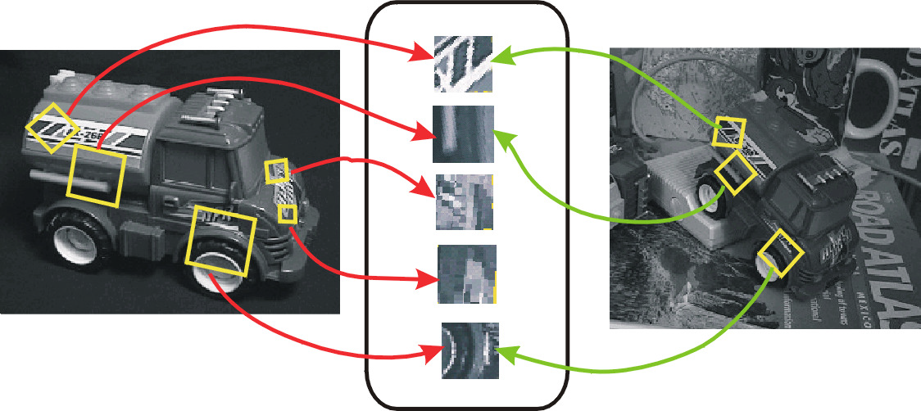
Scale Invariant Feature Transform (SIFT)
Identifies parts of images invariant to scaling, translation, rotation, etc., so that images can be recognized from different viewpoints

Slide 35

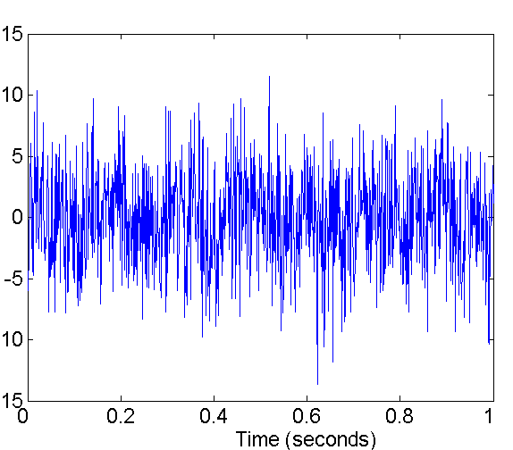
Fourier Transform: features are the sizes of peaks in the frequency domain
After Fourier transform
is applied, the signal to the right decomposes easily into two sine waves
plus noise

Slide 36
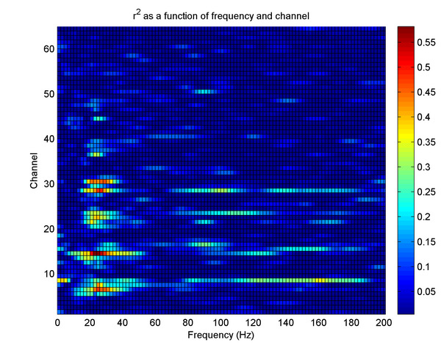
Extraction of Power Bands from EEG signals using Fourier Transform
For a given time window in the raw signal, we extract the power spectrum, segment it into bands, and sum up values in each band.

Slide 37
Software Engineering Example
Software crashes sometimes.
Which part of the program is responsible?
Looking through the entire code may take too much time.
“Features” could be specific lines of code, input values, branches of code executed,
Test with different inputs.
Find which parts of the code were executed in those trials in which crashes occurred.

Slide 38
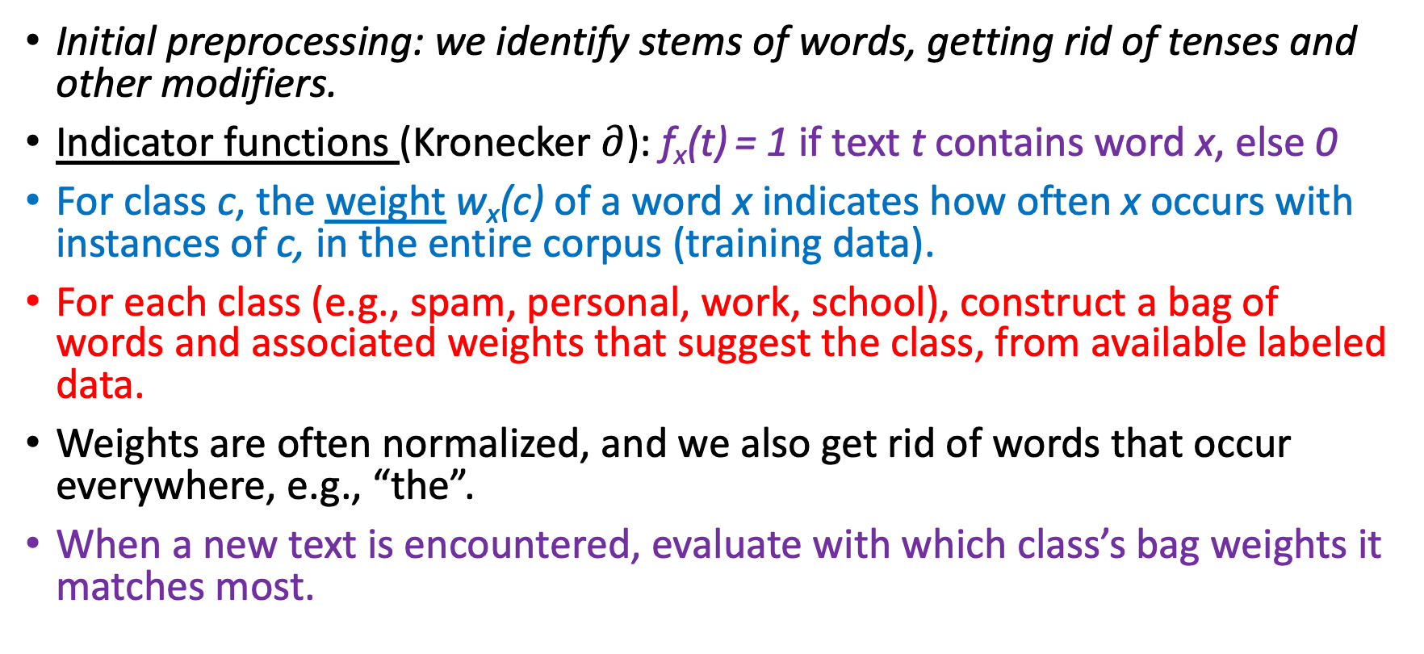
Other Examples of Features—classifying text (content from Alexandre Bouchard-Côté, Univ. of British Columbia)
Initial preprocessing: we identify stems of words, getting rid of tenses and other modifiers.
Indicator functions (Kronecker $∂$): f_{x}(t) = 1 if text t contains word x, else 0
For class c, the weight w_{x}(c) of a word x indicates how often x occurs with instances of c, in the entire corpus (training data).
For each class (e.g., spam, personal, work, school), construct a bag of words and associated weights that suggest the class, from available labeled data.
Weights are often normalized, and we also get rid of words that occur everywhere, e.g., “the”.
When a new text is encountered, evaluate with which class’s bag weights it matches most.

Slide 39
Example: Spam Filtering
Weights for Class School: {CIS: 0.3, HW: 0.3, University:0.3, grade:0.1, reward: 0.001, business: 0.0, opportunity: 0.0, …}
Weights for Class Spam: {CIS: 0.01, HW: 0, University:0.1, grade:0.0, reward: 0.2, business: 0.3, opportunity: 0.25, …}
Message 1: “We have a wonderful new CIS business opportunity for you”-- matched weights sums are 0.3 for Class School and 0.01+0.3+0.25=0.56 for Class Spam.
Message 2: “CIS 662 HW2 is due in two weeks, with a reward for early submission”--matched weights sums are 0.601 for Class School and 0.21 for Class Spam.

Slide 40
Features in text processing: Bigrams, Trigrams, n-grams
In text-processing, phrases are more important for classification than individual words, e.g., “business” may occur in many messages, vs. “business opportunity” which occurs more often in spam.
An “n-gram” is a sequence of tokens (words) of length n, the most important special case is “bigram”=“2-gram” and “trigram”=“3-gram”.
[Nothing to do with “Gramma” or “grammar” or “kilogram” or “Grameena Bank”!]
Bag of words representations may work with n-grams instead of individual words.

Slide 41
What text features are interesting or useful?
How much information does a feature provide towards discriminating between the classes of interest?
Words or phrases that occur everywhere (e.g., “you”)—useless
Words or phrases that occur much more often in a subset of classes, compared to other classes (e.g., “business opportunity”)—useful
Some words or phrases (e.g., “dosage”) may indicate the domain of discourse, but are not useful for other classification purposes.
Rare words or phrases (e.g., “necessitating”)—particularly useful in identifying authors.
[Stylometry: characterizes styles of different authors.]

Slide 42
One-size-fits-all vs. Personalization
What’s spam for you may not be spam for someone in Business School.
Your “normal” behavior may differ from mine.
Machine Learning system designers are aware of the need for personalization; a typical system may begin from what is “normal” or expected for a population, and fine-tune it for specific users upon deployment.

Slide 43
Term Frequency-Inverse Document Frequency (TFIDF)
Term Frequency tf(t,d): how frequently term t occurs in document d
Example: if “rose” occurs 20 times in an essay with 1000 words, then tf(rose, that essay)=20/1000=0.02
Important Variation: replace the denominator by the frequency of the most frequently occurring term in the document.
Inverse Document Frequency: log₂(total no. of documents/no. of documents containing the term)
Example: if “rose” occurs in 20 out of 1000 documents, then log₂(1000/20)= about 5.5.
TFIDF: product of these two.
Above Example: (0.02)(5.5) = 0.11

Slide 44
Discretization
Sometimes, it is useful to transform continuous variables into discrete ones, e.g., from a height attribute to {short, medium, tall}.
This may be problem-specific: what’s appropriate for horse-riding jockeys may not be appropriate for NBA basketball players.
When no labeled data are available, discretization algorithms may create equal-sized intervals, e.g., [4.5, 5.0), [5.0, 5.5), [5.5, 6.0), [6.0, 6.5), [6.5, 7.0), [7.0, 7.5).
An alternative is “equal density” binning: ensure that each bin has the same amount of data, e.g., for NBA players, we may have the bins [4.5, 6.1), [6.1, 6.4), [6.5, 6.7), [6.8, 6.9), [6.9, 7.5)
Fuzzy sets permit partial membership, e.g., an NBA player 6’4” may be considered “0.2 short, 0.7 medium, 0.1 tall”.
Notes:
Drawback of Equal Width Discretization:
One major drawback of equal width discretization is that it may not handle data distributions with varying data densities effectively.
Equal width binning divides the data into fixed-width intervals, which means that each bin has the same width regardless of how many data points fall into it. This can lead to uneven representation of data points in the bins, especially when the data distribution is not uniform.
In cases where the data distribution is skewed or has varying densities, equal width discretization may result in bins that contain very few data points (underflow) or too many data points (overflow), making it challenging to capture meaningful patterns or relationships in the data.

Slide 45
Clustering vs. Feature Extraction
Some authors consider cluster membership in the data space to be a feature—we don’t!
What we call a feature ought to be a robust definition, not having to change if new data is added to the data set.
From our perspective, feature extraction is the step performed before (supervised or unsupervised) learning, not after!

Slide 46
Occam’s Razor
My version: If you have the choice of purchasing an acceptable razor for $10 or an excellent razor for $100, what would you prefer?
In science, simpler systems, theories, and explanations are preferred to complicated ones.
But we make tradeoff decisions, e.g., preferring the excellent razor if it is on sale for $15.

